Slide 1
Client vs. Server side Scripting
Php Introduction
By:-Asstt. Prof:-Keshav
Computer Application Department

Slide 2
Client Side Scripting VS. Server side Scripting
A script code of the website runs on the client side is known as client side scripting
It execute on the browsers like internet explorer, Mozilla Firefox
Java script and VB script language are used for client side scripting .
It is mainly used for validation on web page.
A script code of the website runs on the server side is known as server side scripting
It executes on the server like IIS, Apache, glass fish.
PHP,ASP and JSP languages used for Server side scripting
It is used for developing the business logic and connecting to the database.

Slide 3
Client Side Scripting VS. Server side Scripting
Client side scripting works at the front end and scripts are visible among the users
Client side scripting does not need any interaction with the server
Less secure as the client-side script is visible to the usrers.
Server side scripting works in the back end which could not be visible at the client end.
Server side scripting require server interaction
Server side scripting is more secure than client side scripting as the server side scripts are usually hidden from the clients/users.

Slide 4
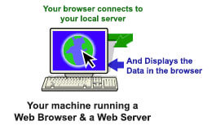
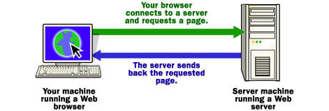
Local Server Vs Remote Server
Local Server
Remote Server

Slide 5
What is PHP?
PHP stands for :Hypertext Preprocessor
Php is a widely used ,open source scripting language
PHP script are excuted on the server
PHP is free to download and use.
PHP supports multiple platforms.You can run PHP on Windows,Linux, Mac etc.
PHP supports wide range of database.Users can integrate PHP with MySQL,Oracle,Sybase and Microsoft sql server.

Slide 6
PHP Syntax
<?php
//php code
?>

Slide 7
Embedding PHP Code in Web pages
<html>
<head>
<title>First PHP Page</title>
</head>
<body>
<?php
echo “Hello world”; //php code
?>
</body>
</html>

Slide 8
PHP Tokens
In language like English individual words and punctuation symbols are used to make a sentence or paragraph. These individuals units are called as tokens.
PHP tokens majority fall into following categories :
Variable
Constants
Operators
Expression

Slide 9
Variable
Syntax of variable
$variable name=value;
Some rules of variables:
Starts with $ sign
Variable name start with letter or underscore
Variable names are case sensitive
Variable name cannot starts with numbers
Variable does not contain any space in between.

Slide 10
Program :use of different variables
<html>
<head>
<title>PHP variables</title>
</head>
<body>
<?php
$x=5;
$y=6;
$z=$x+$y;
$txt=“Good morning”;
echo $z;
echo $txt;
?>
</body>
</html>

Slide 11
Scope of PHP variables
Local
Global
Static

Slide 12
Constant
A Constant is a identifier and its value cannot change during the execution of the script
No $ sign used before the constant name.
define () function takes three parameters
The first parameter defines the name of the constant
Second parameter defines the values of the constant
The third parameter specfies whether the constant name should be case-sensitive or not.

Slide 13
Program of constant
<html>
<head>
<title> PHP</title>
</head>
<body>
<?php
define(“PI”,3.14);
echo PI;
?>
</body>
</html>

Slide 14
Thank you

